Slide 1
E-Commerce Analytics
Full Project Report
Sales · Products · Operations · Customers
500K+ Rows
2016–18
5 Pages
40+
Before Cleaning
Date Range
FY 17 - 19
Dashboard
DAX Measures
Powered by MySQL · Power Query · DAX · Power BI Desktop
Group Member: Aisha Farah
: Jenipher Wanyoike
: Winslet Naserian
Angani Sales Data • Product Master • Angani Ecommerce MySQL Database

Slide 2
Table of Contents
Business Understanding
Dashboard Pages
01
06
Problem statement and business objectives
5 pages — Overview, Sales, Products, Operations, Customers
Data Pipeline & Cleaning
Key Insights
02
07
Power Query steps, vendor column, MySQL import
Findings with real values from the data
Exploratory Data Analysis
Recommendations
03
08
Statistical findings, correlations, patterns
4 actionable recommendations for the business
DAX Measures
Challenges & Data Limitations
04
09
40+ measures across 6 categories
MySQL connector issues, data quality problems
SQL Validation
Limitations & Future Work
05
10
14 queries, EER diagram, Power BI cross-check
What data cannot tell us and what to do next

Slide 3
01 — Business Understanding
Problem Statement
Business Objectives
Extracting meaningful information from raw datasets could be a difficult task, especially when it spans several years. This often hinders business owners and stakeholders from making accurate data-driven decisions. To measure trends in revenue, identify the products with the highest sales, and assess customers’ transaction preferences, the datasets for this store need to be properly modelled, analyzed, and visualized for efficient decision-making.
• Track revenue, orders, average order value and discount rates
• Identify which products and categories drive the most revenue
• Measure cancellation and refund rates — quantify money lost
• Understand customers — new vs repeat, top spenders, churn
• Identify which commission channels generate most revenue
• Compare revenue across financial years to confirm growth
• Deliver a simple interactive dashboard anyone in the business can use

Slide 4
02 — Data Pipeline & Cleaning
Part 1 of 3
Excel Source
Power Query
MySQL Database
Power BI Model
Sales (77k+)
Products (84k+)
▶
Cleaned &
transformed
▶
EcommerceDW
14 SQL queries
▶
Star Schema
via SKU_ID
Sales Table — What Was Cleaned
Products Table — What Was Cleaned
• Removed duplicates, blanks and formula error rows (~314 rows excluded)
• Fixed all column data types — dates, numbers and text
• Standardised Status values using Text.Proper — removed inconsistencies
• Renamed BI Flag to Order Outcome (Confirmed Order / Unconfirmed Order)
• Added Actual Item Total column — Price × Qty − Discount Amount
• Status labels cleaned — underscores removed (e.g. Pending_Paypal → Pending Paypal)
• Removed blank and duplicate SKU rows throughout the table
• Standardised Category and SKU column values
• Vendor column removed — full story on the next slide
• Date Table built in DAX — Year, Month, Quarter, Weekday, Financial Year
• Date Table marked as Date Table and linked to Created_At column
• Revenue Rank and Cumulative Revenue % columns added for Pareto chart

Slide 5
02 — Data Pipeline & Cleaning
Part 2 of 3 — The Vendor Column
The Vendor column has an interesting story — it was built twice, in two different tools, for two different reasons and later removed completely
Version 1 — DAX Calculated Column (Original)
Version 2 — Power Query Column (Improved)
• The first Vendor column was created in Power BI using a DAX formula
• Logic: if SKU contains an underscore, take the text before it as the vendor's name
• If SKU has no underscore, label it as Direct Brand
• If SKU is blank, label it as Unknown
• Problem: DAX calculated columns run every time the data refreshes — slower performance on large tables
• The Vendor column was moved to Power Query during the data cleaning stage
• Same logic: extract text before the underscore as the vendor's name
• Power Query runs once at data load — not on every refresh
• Handles nulls and edge cases more safely than DAX for text operations
Why It Was Removed
Vendor names in this dataset are not stored as a separate field. They are embedded inside the SKU code as a prefix before the underscore. Due to data type inconsistencies in the SKU column, vendor extraction could not be completed reliably. Revenue by Sales Channel on the Sales page provides an alternative view of partner performance using the Sales Commission Code instead.

Slide 6
02 — Data Pipeline & Cleaning
Part 3 of 3 — All Calculated Columns
These columns were added to enrich the data beyond what the source files originally provided:
Order Outcome
Actual Item Total
Labels each order Successful or Unsuccessful — filters out cancelled and refunded orders from revenue reports
Price × Quantity − Discount — gives the real value of each line item after discounts
Customer Type
Commission Channel
Repeat Customer or New Customer — checks if Customer ID appears more than once in the dataset
Extracted from the Sales Commission Code middle segment — shows which partner each order belongs to
Acquisition Year
Revenue Rank + Cumulative %
Extracts the year from Customer Since date — used to track which year each customer first bought
Ranks products by revenue and calculates running cumulative % — both used to build the Pareto chart

Slide 7
03 — Exploratory Data Analysis
Part 1 — What We Found First
Before building any dashboards, we explored the raw data to understand what was in it. Here is what we found:
Data Quality & Scale
Distribution & Skewness
Patterns Found in the Data
• 77,000+ sales transactions across 2016–2018
• 84,000+ product records in the Product Master table
• All sales rows successfully matched a product via SKU_ID
• Created_At confirmed as proper Date type in Power Query
• Mean (average) order value is HIGHER than the median
• This means the data is right-skewed — positively skewed
• A small number of very large orders pull the average up
• The median gives a more honest picture of a typical order
• Outlier orders detected above the calculated IQR threshold
• 16% cancellation rate found — guided the problem statement
• COD identified as the dominant payment method
• Revenue grew 147% from 2016 to 2017 — very strong year
• 2018 data is a partial year — declining trend is misleading
•

Slide 8
03 — Exploratory Data Analysis
Part 2 — Correlations Tested
We tested whether key variables had any meaningful relationship with revenue. Both returned zero correlation:
Revenue vs Quantity Sold — Zero Correlation
NO RELATIONSHIP FOUND
• Selling more items does NOT guarantee more revenue in this business
• Some single-item orders generate more revenue than multi-item orders
• Pricing is inconsistent across products — some items are underpriced
• Quantity alone cannot be used to predict or grow revenue
• Business implication: fix pricing strategy, not just volume targets
Revenue vs Discounts Given — Zero Correlation
NO RELATIONSHIP FOUND
• Giving discounts has NO measurable impact on revenue whatsoever
• Every discount given is pure cost with no return benefit
• Customers do not spend more when discounts are applied
• The business is giving money away without increasing orders or spend
• Business implication: stop blanket discounts, use targeted ones only

Slide 9
04 — DAX Measures & Calculations
Part 1 of 2
Revenue & Orders
Order Status & Operations
Customer Analysis
• Total Revenue, Total Orders, Average Order Value
• Total Discount, Average Discount Rate
• Total Items Sold, Revenue Per Item
• Net Revenue — revenue after all discounts applied
• Discounted vs Non-Discounted Revenue
• Total Completed, Cancelled, Refunded, Pending
• Cancellation Rate — 16% of all orders
• Refund Rate — 1% of all orders
• Completion Rate — % of orders that succeeded
• Lost Revenue — KES 199M from cancellations
• Lost Revenue % — 30% of total revenue lost
• Unique Customers, Revenue Per Customer
• Repeat vs New Customers count
• Repeat Customer Rate — % who came back
• Customer Cancellation Rate
• Churned Customers & Churn Rate
• Discounted Customers vs Non-Discounted Customers
• Top 10 Customer Revenue %

Slide 10
04 — DAX Measures & Calculations
Part 2 of 2
Products & Commission
Time Intelligence
EDA & Data Quality
• Total Products — DISTINCTCOUNT of SKU IDs
• Top 20 Products Revenue
• Revenue by Commission Channel
• Category Revenue % contribution
• Revenue Target — 20% above prior year
• Avg Customer Tenure Days
• Revenue MTD, QTD, YTD — running totals
• Revenue Last Month — prior month comparison
• MoM Revenue Change — used in waterfall chart
• MoM Growth Rate — month on month %
• Revenue SPLY — same period last year
• YoY Growth Rate, Opening & Closing Balance
• Median Order Value — more honest than mean
• Revenue Std Dev, Q1, Q3, IQR (all hidden)
• Outlier Threshold — flags abnormal orders
• Outlier Orders & Outlier Revenue
• Skewness Indicator — confirms right skew
• Excluded Rows & Matched Products
All measures stored in a dedicated Measures table — keeps the Fields pane clean and follows Power BI best practice
ℹ

Slide 11
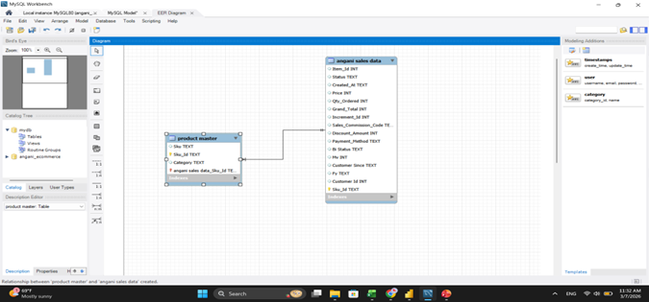
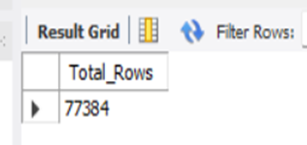
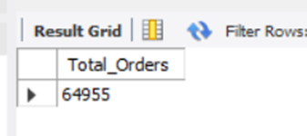
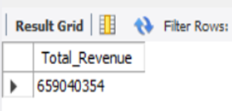
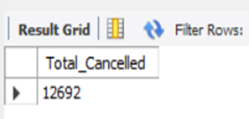
05 — SQL Validation — MySQL Database
What Was Done in MySQL
[ Paste — MySQL EER Diagram Screenshot ]
• Created EcommerceDW database in MySQL Workbench
• Imported Sales (77k+ rows) and Products (84k+ rows)
• Set timeout commands to handle large file import without cutoff
• Tables linked via SKU_ID — confirmed with EER diagram
• 14 validation queries run across all key business metrics
• ~314 row gap between MySQL and Power BI documented and explained
SQL ↔ Power BI Cross-Validation
SQL Query | Power BI Match
COUNT(*) | Total Rows
COUNT(DISTINCT Increment_Id) | Total Orders
SUM(Mv) | Total Revenue
WHERE Status = 'Canceled' | Total Cancelled
WHERE Status IN Refund types | Total Refunded

Slide 12
06 — Dashboard Pages
5 pages + hidden EDA page
Business Overview
Sales & Revenue
Products & Vendors
• Navigation buttons linking to all 4 detail pages
• 5 KPI cards — Revenue, Orders, Cancel Rate, Completion, YoY
• Revenue trend, Top Categories, Orders Funnel, BI Status donut
• FY and BI Flag slicers controlling all visuals at once
• Revenue vs Target gauge, Revenue trend bar chart
• Top categories, BI Status donut, Sales channel bar chart
• Avg Discount Rate on KPI — discount impact visible
• Status vs BI Status stacked bar — full width bottom
• Categories first (big picture) then Top 10 Products (detail)
• Pareto chart — which products drive 80% of revenue
• Product detail table with YoY growth column added
• Top 20 Products Revenue KPI card
Operations
Customer Analysis
Data Exploration (Hidden)
• Cancellation Rate gauge — visual alarm dial
• Orders by Status funnel — shows the drop-off story
• MoM Revenue waterfall — green up, red down months
• Top 3 payment method % cards (COD, EasyPay, PayAxis)
• New vs Repeat Customers donut, Revenue by Type bar chart
• Customer acquisition line chart, Churn Rate by Year bar
• Churn Rate card, Discounted vs Non-Discounted customer cards
• Customer behaviour by Status bar — full width bottom
• Hidden page — reviewer can unhide to inspect
• Statistical cards — Mean, Median, Outliers, Skewness
• Distribution charts — Revenue by Month, Status, Payment
• Correlation findings shown as insight text boxes

Slide 13
06 — Dashboard — Explanatory Text Boxes
Added to visuals for non-technical viewers
Sales & Revenue — BI Status Donut
Sales & Revenue — Order Outcome Slicer
Valid = confirmed legitimate transaction. Net = revenue after deductions. Gross = full face value before deductions.
Successful Order = Complete, Received, Paid, Closed. Unsuccessful = Cancelled, Refunded, Pending.
Products & Vendors — Pareto Chart
Products & Vendors — Vendor Column
The red line marks 80%. Products to the left of where the gold line crosses it drive 80% of all revenue.
Vendor names are extracted from the SKU prefix. If SKU naming changes in future, vendor classification will need updating.
Operations — Waterfall Chart
Customer Analysis — Churn Rate Card
Green bars = months where revenue went up. Red bars = months where revenue dropped. Height shows the amount of change.
Churn rate shows % of 2017 customers who did not return in 2018. Higher number means more customers are being lost.
Customer Analysis — Discount Cards
EDA Page (Hidden) — Skewness Indicator
If Discounted Customers and Non-Discounted Customers are similar in number, discounts are not attracting more unique buyers.
A positive number means a few large orders are pulling the average above what a typical order actually looks like.

Slide 14
07 — Key Insights
KES 659M
16%
KES 199M
1%
183.16%
Total Revenue
Cancellation Rate
Lost Revenue
Refund Rate
YoY Growth 2016→17-18
Revenue & Growth
Operations & Loss
• Revenue grew 147% from 2016 to 2017 — very strong growth
• 2018 is a partial year — declining trend line is misleading
• COD is the single largest revenue driver across all channels
• 100% of sales go through commission — no direct sales exist
• 16 in every 100 orders cancelled — above healthy threshold
• KES 199M lost — that is 30% of total revenue disappearing
• COD carries highest cancellation risk — no upfront commitment
• Two refund statuses suggest an inconsistent returns process
Customers
Discounts & Pricing
• Discounted customers vs non-discounted now measured and visible
• Churn rate calculated — customers lost year on year now tracked
• Top 10 customer revenue % — business dependency now visible
• Zero correlation — discounts do NOT increase revenue
• Zero correlation — more items sold does not mean more revenue
• Every discount is pure cost with no measurable return
• True profit margin unavailable — no cost price data exists

Slide 15
08 — Recommendations
Reduce the Cancellation Rate Urgently
Stop Giving Discounts That Do Not Work
• Zero correlation proven — discounts have no measurable impact on revenue
• Every discount given is pure cost with absolutely no return benefit
• Eliminate blanket discount strategies immediately
• Replace with targeted discounts for repeat customers only
• Redirect the discount budget into customer retention programmes
• 16% cancellation rate = KES 199M in lost revenue every cycle
• COD is the biggest driver — no customer commitment before delivery
• Introduce upfront payment incentives — small discount for prepaid orders
• Add cancellation friction — require a reason before allowing cancellation
• Target: reduce cancellation rate below 10% within 6 months
01
02
Invest in Customer Retention
Fix Data Collection for Future Analysis
• Acquiring new customers costs more than keeping existing ones
•Loyalty programs should be offered to high-value customers identified by average sales per customer.
• Even converting 5% of one-time buyers to repeat customers grows revenue
• Use the Customer Analysis dashboard to identify and target top spenders
• Add product cost price — enables true profit margin analysis
• Add shipping date — enables delivery time and fulfilment analysis
• Ensure 2019 data covers the full calendar year for accurate YoY
• Consider adding customer location for regional performance analysis
03
04

Slide 16
09 — Challenges & Data Limitations
Part 1 — MySQL Connection Story
MySQL Connection — What We Tried & What Happened
Step 1 — MySQL Import Succeeded
Both tables were successfully imported into the EcommerceDW database in MySQL Workbench. 14 validation queries were run and all results matched Power BI measures — data integrity confirmed.
Step 2 — Connector/NET Failed
MySQL Connector/NET was installed to connect MySQL directly to Power BI. Despite a successful installation, Power BI could not detect it. Root cause: a 32-bit vs 64-bit version mismatch on a restricted admin laptop with no admin access to fix it.
Step 3 — Connector/ODBC Worked But Was Too Costly
MySQL Connector/ODBC installed and worked technically. However, switching data sources at that stage would have required rebuilding all 40+ measures, calculated columns and visuals from scratch. Not viable within the project deadline.
Step 4 — CSV Source Change Triggered Errors
We attempted to change the Power BI data source from Excel to CSV exports from MySQL directly. This triggered cascading errors across every visual and measure in the report. We reverted immediately to the working state.
Final Decision: Excel kept as data source. MySQL work still stands — used for validation and integrity confirmation, not just for show.

Slide 17
10 — Limitations & Future Work
Current Limitations
Recommended Future Work
• No cost price data — true profit margin cannot be calculated at all
• No shipping date column — delivery times and fulfilment analysis not possible
• 2018 is incomplete — full year YoY comparison is misleading
• MySQL connector could not be linked to Power BI directly
• Vendor extraction depends on SKU naming — if convention changes, it breaks silently
• No customer location data — regional sales analysis not possible
• Two separate refund statuses show inconsistent data entry across teams
• Customer IDs are anonymous numbers — no demographic profiling possible
• Add product cost price — enables true profit margin and pricing decisions
• Add shipping date — enables delivery time analysis and fulfilment tracking
• Collect full year 2018 and 2019 data for accurate trend comparisons
• Fix MySQL connector — enables live data refresh directly in Power BI
• Standardise refund process — one status only across all teams
• Add customer location data — enables regional sales breakdown
• Build predictive models — forecast future revenue and cancellation rates
• Schedule automatic data refresh — move from static Excel to live MySQL

Slide 18
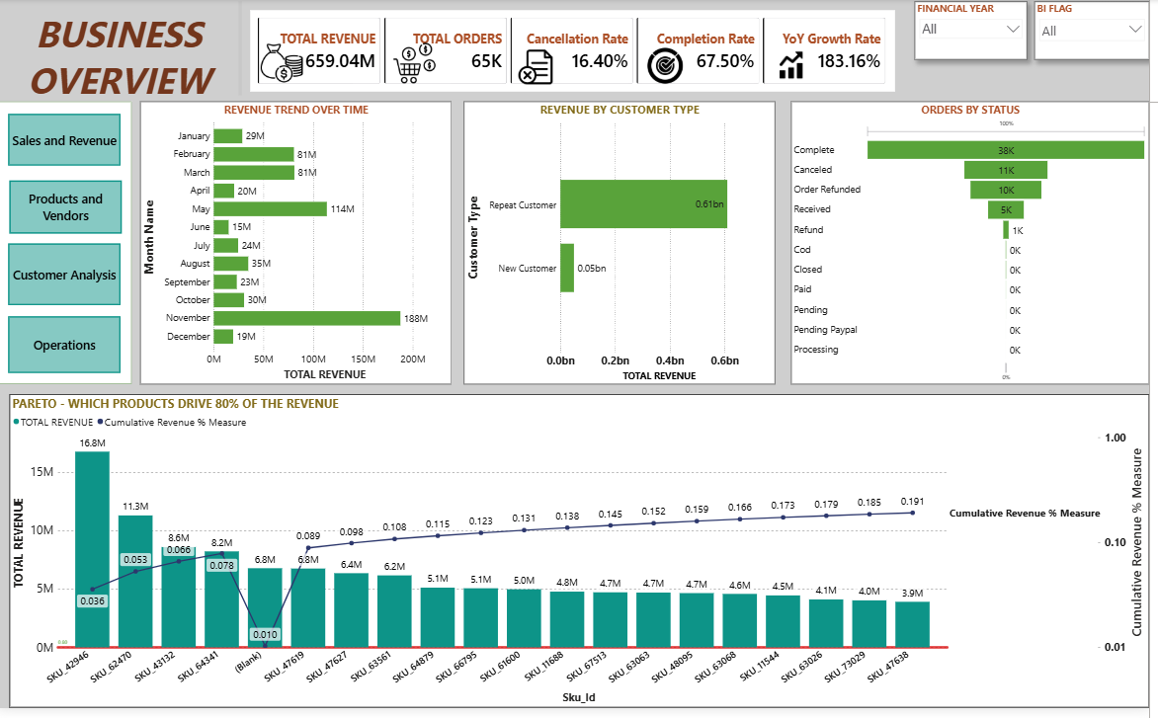
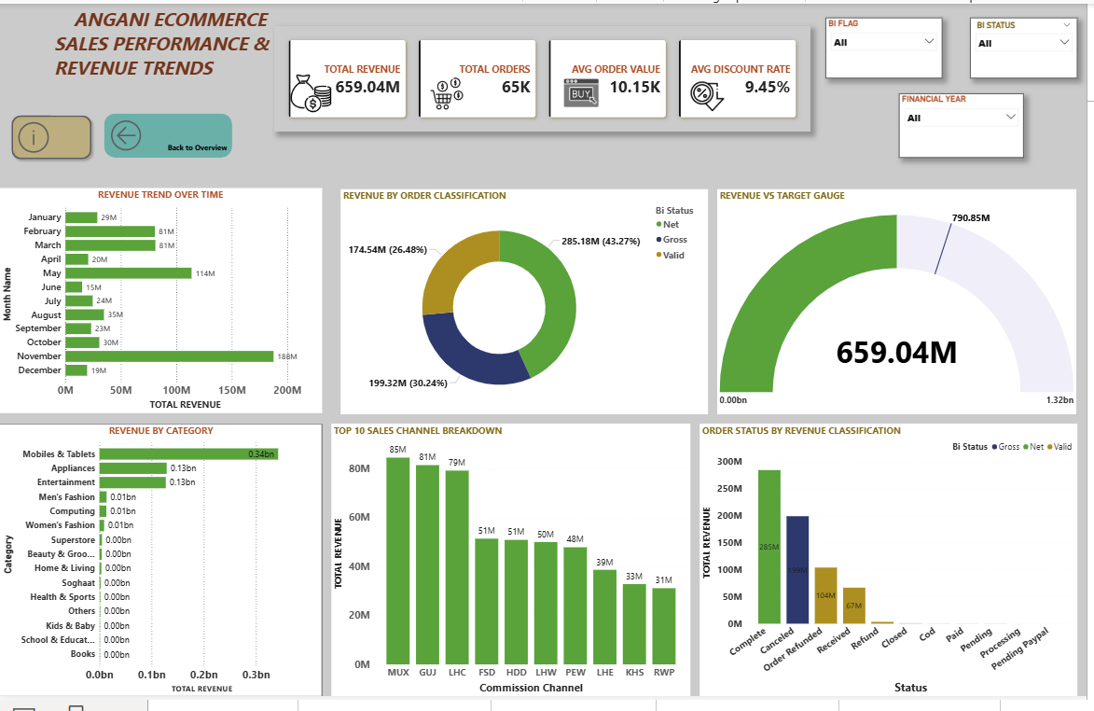
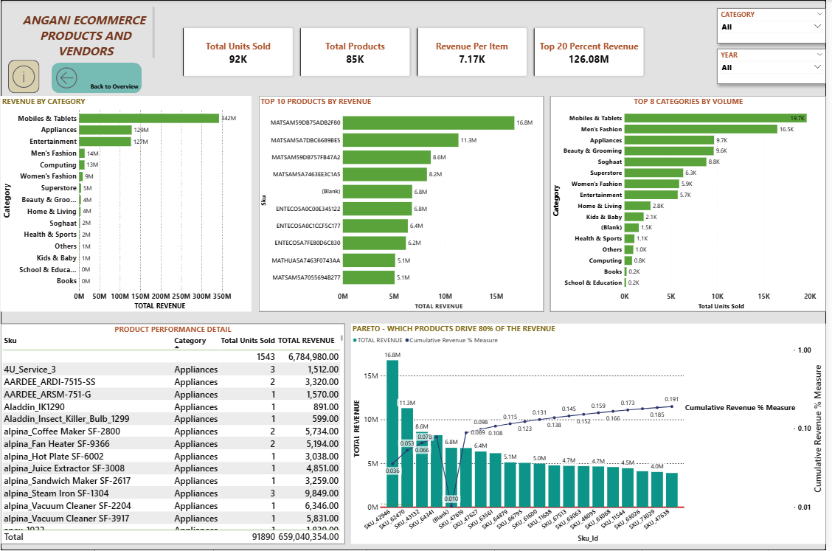
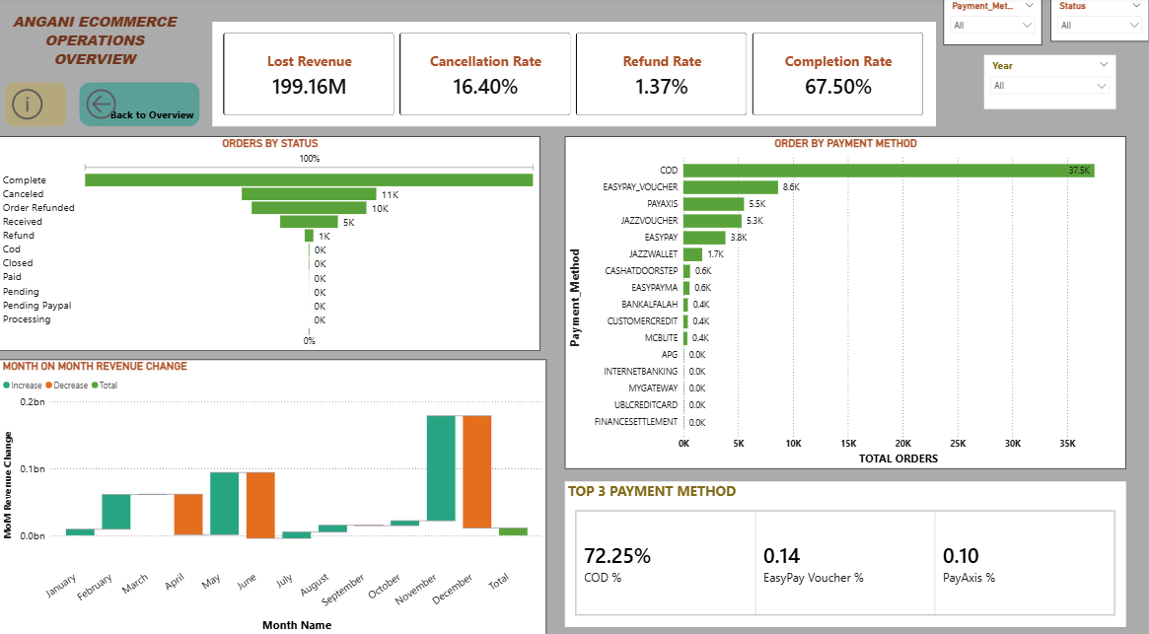
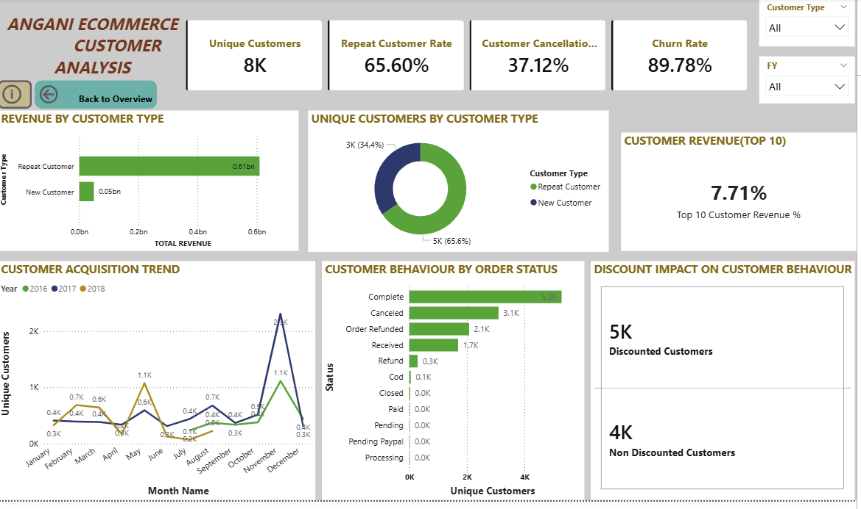
Dashboard Screenshots
[ Paste Screenshot
Business Overview ]
[ Paste Screenshot
Sales & Revenue ]
[ Paste Screenshot
Products & Vendors ]
[ Paste Screenshot
Operations ]
[ Paste Screenshot
Customer Analysis ]
Windows + Shift + S to screenshot • Paste into each box • Resize to fit

